Slide 1
Effective Pattern Discovery for Text Mining
INTERNAL GUIDE:
MS.G.SUMALATHA
GROUP MEMBERS:
V. SHESHU KUMAR-11311A1278
K. SAI SURAJ-11311A1279
V. VAMSHI KRISHNA-11311A12A1
S.VIVEK ROSHAN-11311A12A8
PROJECT COORDINATOR:
MR. K. KRANTHI KUMAR

Slide 2
Contents:
Abstract
Existing System
Proposed System
Project Overview
Project Scope
Software Technologies
Features
Project Description

Slide 3
Abstract:
Many data mining techniques have been proposed.
Effective use and update discovered patterns is still an open research issue.
Most existing text mining methods adopted term-based approaches.
They all suffer from the problems of polysemy and synonymy.
polysemy means a word has multiple meanings, and synonymy is multiple words having the same meaning.

Slide 4
The hypothesis that pattern (or phrase)-based approaches should perform better than the term-based ones.
This project presents an innovative and effective pattern discovery technique
And this includes the processes of pattern deploying and pattern evolving, to improve the effectiveness of using and updating discovered patterns for finding relevant information

Slide 5
Existing System:
Since most text mining methods adopted term-based approaches, they all suffer from the problems of polysemy and synonymy.
There has been hypothesis that phrase based performs well.
Disadvantages:
1. Phrases have inferior statistical properties to terms.
2. They have low frequency of occurrence, and
3. There are large numbers of redundant and noisy phrases among them

Slide 6
There are methods to discover patterns.
The problem in existing system is that how can we effectively use the discovered patterns
Existing system only lets us to discover patterns
Techniques like association rule mining and frequent pattern mining are those earlier approaches to mining.

Slide 7
Proposed System:
Here we present an effective pattern discovery technique.
It calculates discovered specificities of patterns initially.
Now it evaluates term weights according to the distribution of terms in the discovered patterns.
Where as the distribution of weights is done in the whole document in the previous methods.

Slide 8
It also considers the influence of patterns from the negative training examples to find ambiguous (noisy) patterns.
The process of updating ambiguous patterns can be referred as pattern evolution.
The proposed approach can improve the accuracy of evaluating term weights because discovered patterns are more specific than whole documents.

Slide 9
In this project we use two major ideas i.e.,
D-pattern and Inner Patterns(IP) evaluation.
D-patterns:
It is used to discover the patterns from the positive documents ,then it calculates the support and evaluate the weights
IP evaluation:
In the inner pattern evolving the noisy documents are identified ,these error patterns are removed and shuffling is done

Slide 10
Process:
We first pre-process the data.
Apply stop-list on the pre-processed data.
Compute paragraph set.
Compute term set.
Evaluate the patterns for the obtained terms.
Compute D-patterns.
Compute IP evaluation.

Slide 11
Project overview:
Many types of text representations have been proposed in the past.
This project presents an effective pattern discovery technique.
Calculates discovered specificities of patterns and then evaluates term weights according to the distribution of terms in the discovered patterns rather than the distribution in documents for solving the misinterpretation problem.

Slide 12
Project scope:
To provide maximum services to the user
Fast response
Facilitate for maintenance of any data
To reduce the memory overhead
Most relevant and accurate results

Slide 13
Features:
User friendliness with correct response
System makes the overall data to be maintained in a specified format
There is no risk of data mismanagement at any level

Slide 14
System Configuration:
Hardware System Configuration:-
Processor - Pentium –III
Speed - 1.1 Ghz
RAM - 256 MB(min)
Hard Disk - 20 GB

Slide 15
Software System Configuration:
Operating System : Windows95/98/2000/XP
Front End : Swings
Scripts : JavaScript.
Database : Mysql 6.0
Database Connectivity : JDBC.

Slide 16
Project Description:
There has been rapid growth of digital data made available in recent years.
Knowledge discovery and data mining have attracted a great deal of attention .
An imminent need for turning such data into useful information and knowledge.
Many applications, such as market analysis and business management, can benefit by the use of the information and knowledge extracted from a large amount of data.
Continued….

Slide 17
It is a challenging issue to find accurate knowledge (or features) in text documents to help users to find what they want.
In the beginning, Information Retrieval (IR) provided many term-based methods to solve this challenge
However, term based methods suffer from the problems of polysemy and synonymy.
Over the years, people have often held the hypothesis that phrase-based approaches could perform better than the term based ones.
In the presence of these set backs, sequential patterns used in data mining community have turned out to be a promising alternative to phrases

Slide 18
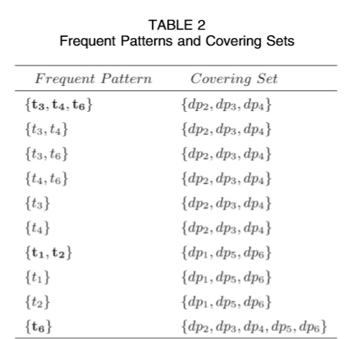
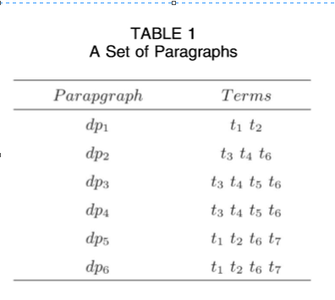
Example:

Slide 19

For your time….

